Slide 1


Slide 2




Cloud Computing and Autonomic Computing:
Perfect Partners for Digital Transformation
GROUP ACTIVITY #2

Slide 3



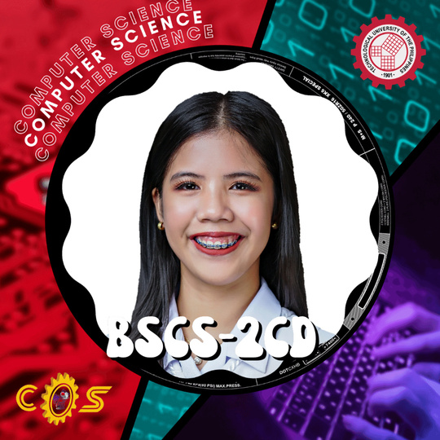

MEET THE TEAM
BARRIOS, ARMAND ANGELO
CALULANG, MARY JANE
OLOROSO, ANDREW

Slide 4
MENTI

Slide 5


Slide 6
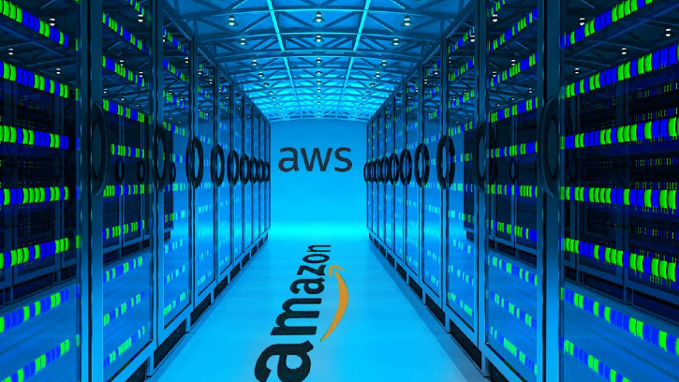

Slide 7
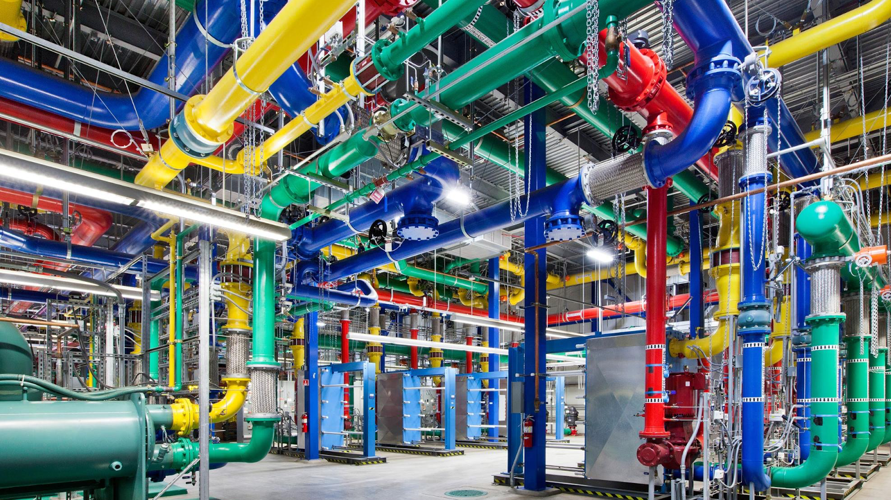

Slide 8


Slide 9
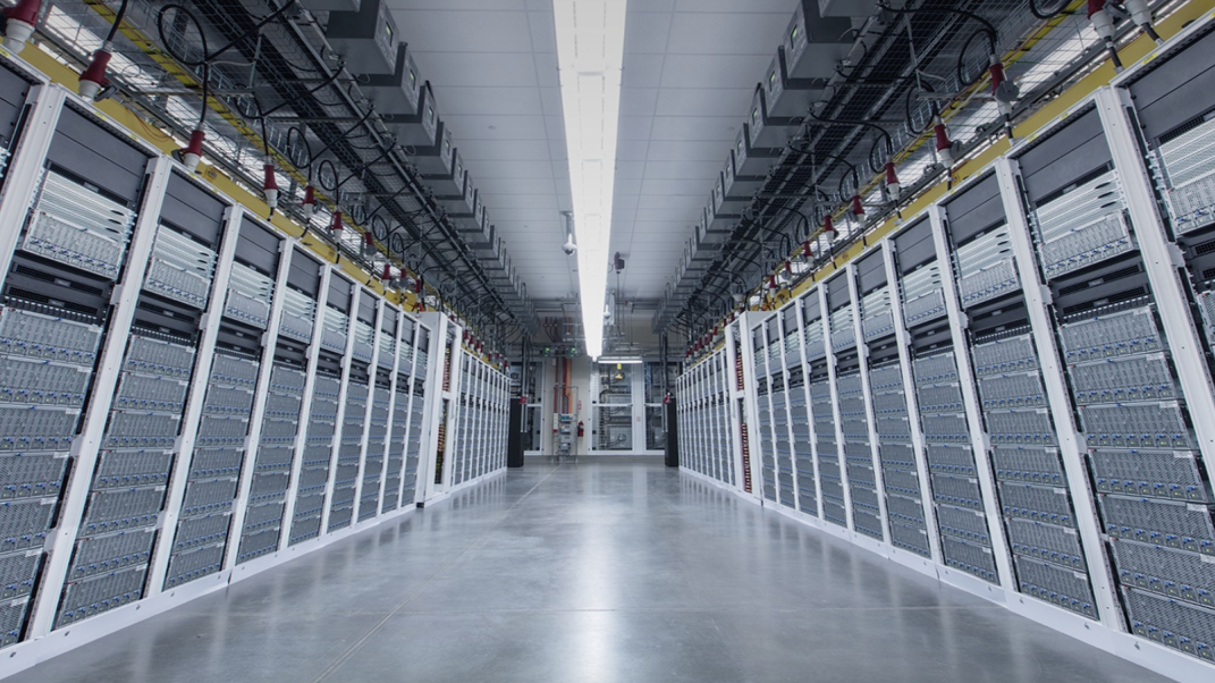

Slide 10
Is Cloud Computing a Data Center?

Slide 11



Slide 12


Slide 13
OBJECTIVES
The specific aims of our research study are as follows:
Define cloud computing and autonomic computing,
Explain evolution of cloud computing,
Explain three (3) types of cloud deployment models,
Describe three (3) Service Models and top cloud providers,
Describe the advantages and disadvantages of both technologies,
Describe some of the application areas of cloud,
Explain how cloud and autonomic computing works in different focus area.

Slide 14

WHAT IS CLOUD COMPUTING?
Cloud computing is the delivery of technology services - including compute, storage, databases, networking, software, and many more - over the internet with pay-as-you-go pricing.

Slide 15
WHAT IS AUTONOMIC COMPUTING?
describes a computer system's capacity to operate autonomously without constant human supervision.

Slide 16
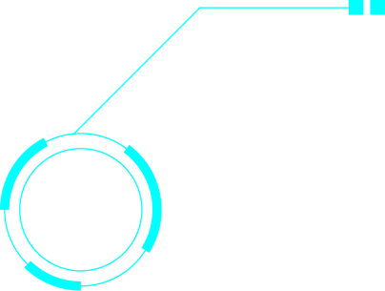
evolution of cloud computing
CLOUD PHASE
allowed organizations to rent computing resources from the cloud, such as servers and storage
PRE-PHASE
larger-scale sharing of computing resources
IDEA PHASE
creation of time-sharing systems

Slide 17
TYPES OF CLOUD DEPLOYMENT MODEL
Important decision in cloud adoption
How much control do you need over your cloud environment?
1.
2
3
private cloud
public cloud
HYBRID cloud

Slide 18

PRIVATE CLOUD
1.
2
3
designated forexclusive use by its tenants.
Private clouds are accessed by a network link.
Pros: Direct control of resources and data
Cons: More upfront investment
Unlike on-premise, private cloud uses virtualization for on-demand compute resources and can be off-premises.

Slide 19
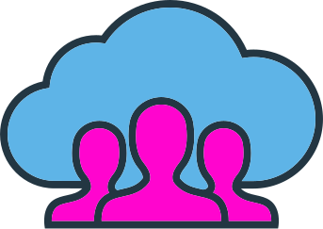
Public CLOUD
shared and open foruse by the general public.
Public clouds are Internet accessible.
Pros:
- Get started quickly with minimal investment
- Easier to scale
Cons:
- No access to data center and hardware
1.
2
3

Slide 20
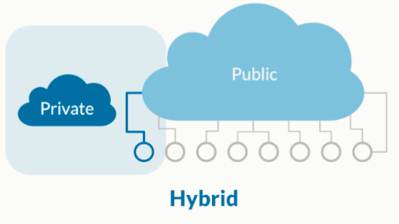
HYBRID CLOUD
Organization uses a combination of two or more distinct models.
Use cases:
Store data on the private cloud and use application on public cloud
Cloud bursting: when private cloud hits capacity, temporarily move overflow to the public cloud
1.
2
3

Slide 21
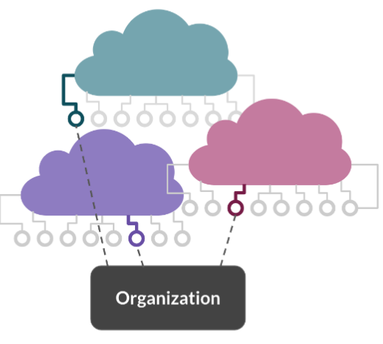
other deployment models
1.
2
Multicloud
Combination of different cloud provider services
Flexibility on pricing plans and service offerings
No reliance on one vendor

Slide 22
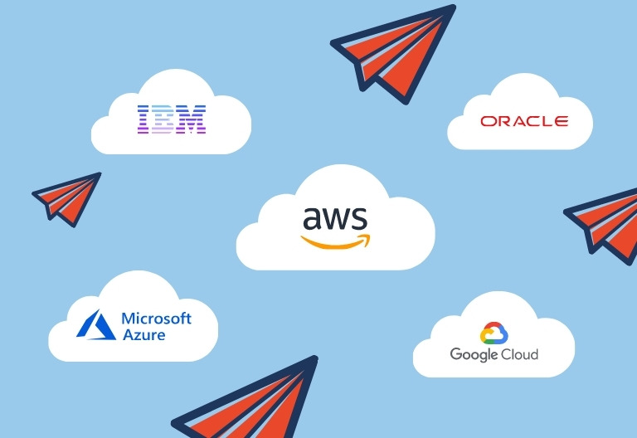
Providers
1.
2
Cloud providers, a.k.a cloud service providers, are third-party IT companies.
Offer on-demand, scalable computing resources and cloud-based services on the Internet.

Slide 23
Providers
Cloud service providers are often categorized by the type of resource they provide:
Software as a Service (SaaS)
Infrastructure as a Service (IaaS)
Platform as a Service (PaaS)

Slide 24
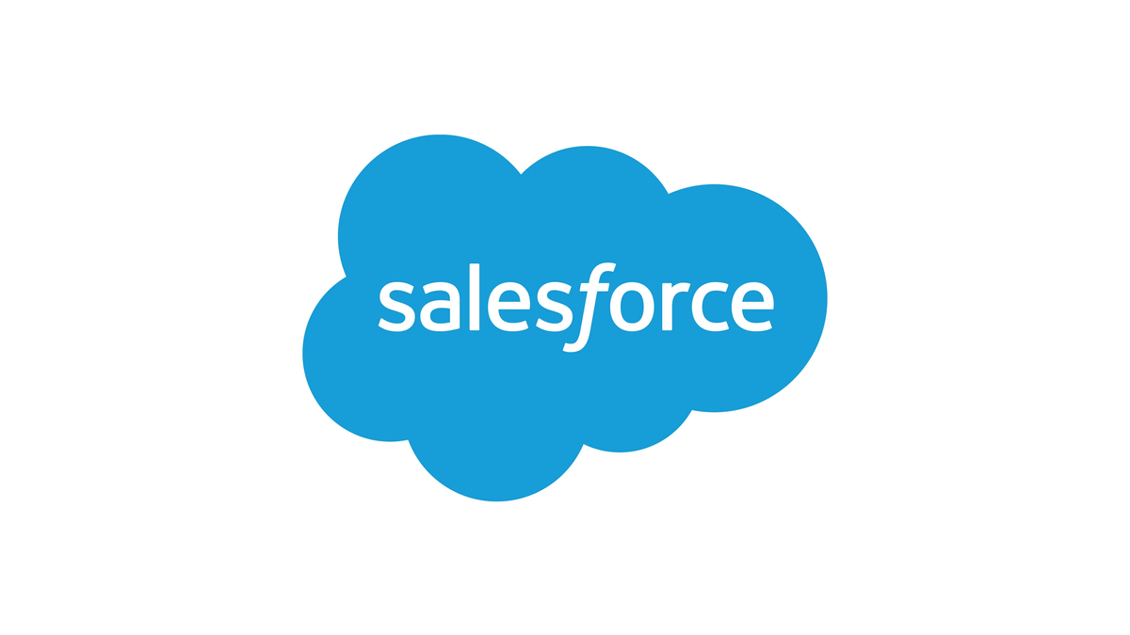
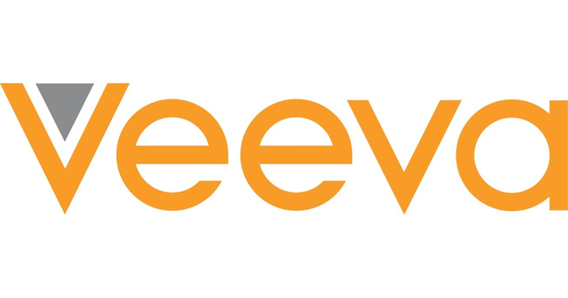

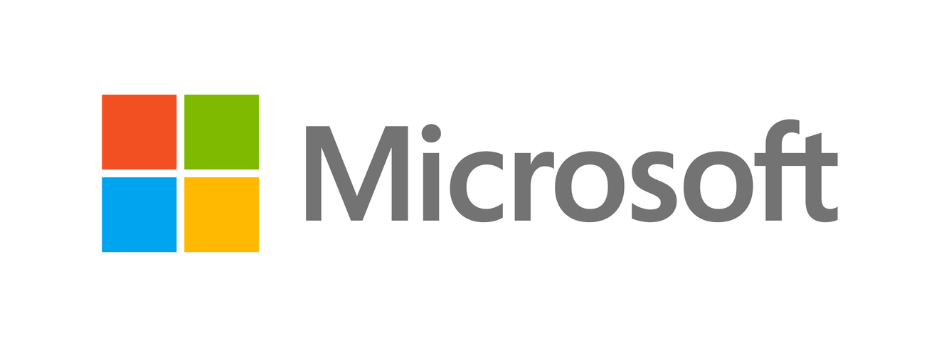
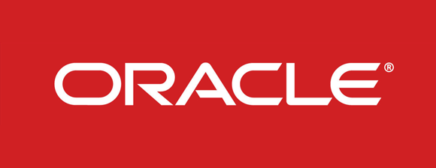
Providers
Software as a service (SaaS) providers
-offer cloud-based software (e.g. CRM, HR, and project management) that are accessed via the internet
-handle everything from infrastructure to data
Notable SaaS providers include Salesforce, Microsoft, Intuit, Veeva Systems, and Oracle.

Slide 25
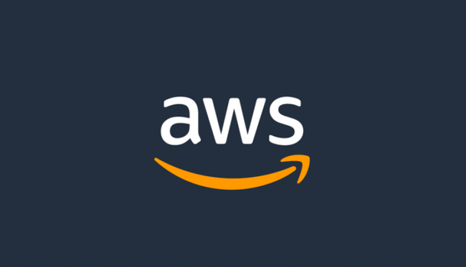

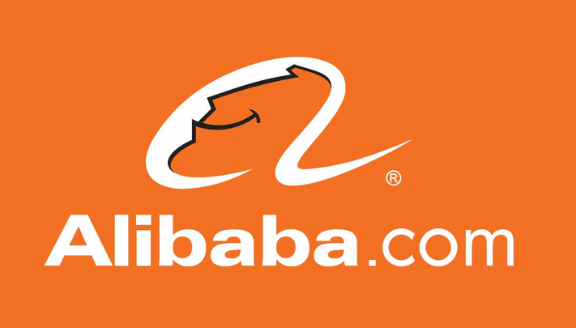
Providers
Infrastructure as a service (IaaS) providers
-offer pay-as-you-go virtualized computing resources and infrastructures, like servers, storage, and networking
-resources can be customized to meet a business' specific needs, and easily scaled up or down.
Some known IaaS providers are AWS, Microsoft, and Alibaba.

Slide 26


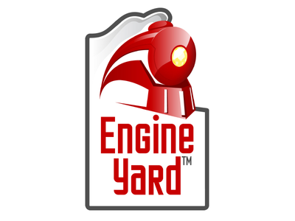
Providers
Platform as a service (PaaS) providers
-offer a comprehensive platform that supports application development, testing, and deployment
-typically provide various development tools, middleware, and operating systems which are hosted in the cloud
Some known PaaS providers include Heroku, Red Hat, and Engine Yard.

Slide 27
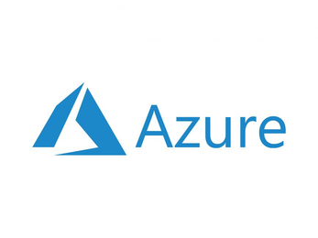
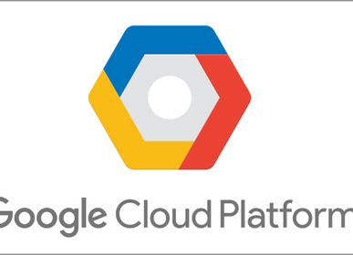
Providers
Amazon Web Services (AWS)
offers a wide range of cloud computing services including IaaS, PaaS, and SaaS
Microsoft Azure
offers similar services as AWS, but focus on integrating with Microsoft software and tools.
Google Cloud Platform (GCP)
offers IaaS, PaaS, and SaaS services as well, with a focus on machine learning and data analytics capabilities

Slide 28
Service models
Software as a service (SaaS)
on-demand access to ready-to-use, cloud-hosted application software
Characteristics of a SaaS
Managed from a central location
Hosted on a remote server
Accessible over the internet
Users are not responsible for hardware and software updates that are applied automatically
The services are purchased on the pay-as-per-use basis
Common examples of SaaS include Google Workspace, Microsoft 365, Slack, InfinCE and ReachOut Suite among others.

Slide 29
Service models
Infrastructure as a service (IaaS)
on-demand access to cloud-hosted physical and virtual servers, storage and networking - the backend IT infrastructure for running applications and workloads in the cloud.
Characteristics of IaaS
Resources are available as a service
Services are highly scalable
Dynamic and flexible
GUI and API-based access
Automated administrative tasks
Popular examples of IaaS include the Amazon Elastic Compute Cloud (AWS EC2), Azure IaaS, Google Compute Engine (GCE), Rackspace, and Cisco Metacloud.

Slide 30
Service models
Platform as a service (PaaS)
on-demand access to a complete, ready-to-use, cloud-hosted platform for developing, running, maintaining and managing applications.
Characteristics of a PaaS
Integrates with web services and databases
Builds on virtualization technology, so resources can easily be scaled up or down as per the organization's need
Support multiple languages and frameworks
Provides an ability to "Auto-scale"
Examples of PaaS include AWS Elastic Beanstalk, Windows Azure, Heroku, Google App Engine, Apache Stratos, Magento Commerce Cloud, and OpenShift.

Slide 31
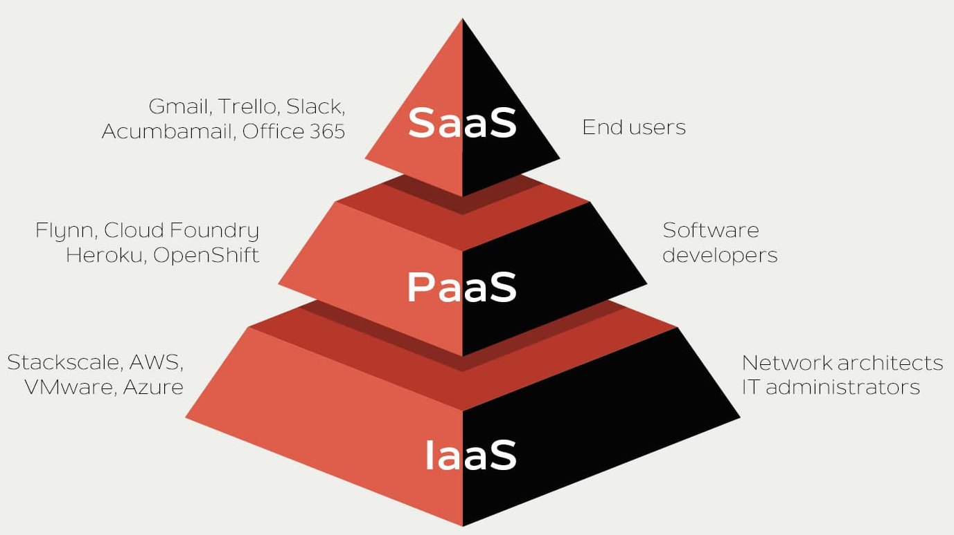

Slide 32
Service models
Other cloud computing service models include:
Network as a Service (NaaS)
Backup as a Service (BaaS)
Database as a Service (DaaS)
Communications as a Service (CaaS)
Cloud Business Process as a Service (BpAAS)
Storage as a Service (STaaS)

Slide 33
ADVANTAGES OF CLOUD COMPUTING

Slide 34



ADVANTAGES OF CLOUD COMPUTING
COST EFFICIENCY
AGILE
CLOUD
ADVANCED 5ECURITY

Slide 35


ADVANTAGES OF CLOUD COMPUTING
RELIABILITY
ACCESSIBILITY

Slide 36
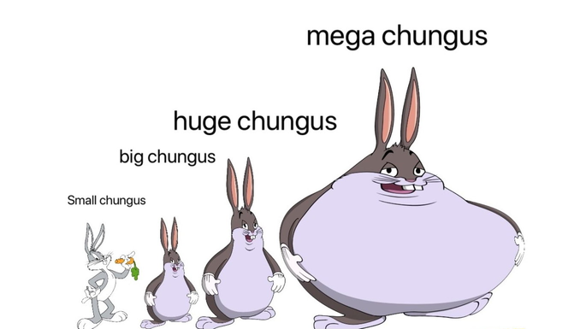

ADVANTAGES OF CLOUD COMPUTING
MASSIVE SCALABILITY
ENVIRONMENTAL SUSTAINBILITY

Slide 37
DISADVANTAGES OF CLOUD COMPUTING

Slide 38

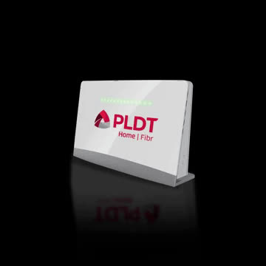


DISADVANTAGES OF CLOUD COMPUTING
SECURITY RISKS
DEPENDENCE ON INTERNET CONNECTIVITY
LIMITED CONTROL

Slide 39



DISADVANTAGES OF CLOUD COMPUTING
DOWNTIME AND OUTAGES
COST
VENDOR LOCK-IN

Slide 40




Recent Developments of Cloud Computing
MULTI-CLOUD STRATEGIES
EDGE COMPUTING
SERVERLESS ?
SERVERLESS COMPUTING

Slide 41



Recent Developments of Cloud Computing
CONTAINERIZATION
HYBRID CLOUD
AI AND MACHINE LEARNING

Slide 42

Relation to Autonomic Computing
Autonomic computing aims to create self-managing computer systems that can perform tasks without human intervention.
Cloud computing, on the other hand, provides on-demand access to shared computing resources, such as servers, storage, and applications, over the internet.
By combining these technologies, cloud computing providers can create self-managing systems that can automatically scale resources up or down based on demand, monitor system performance and security, and detect and respond to issues in real-time.
+
=
CLOUD COMPUTING
AUTONOMIC COMPUTING

Slide 43

SUMMARY
Cloud computing has completely changed how we manage, access, and store data.
Increased automation and self-management of cloud systems are made possible by autonomous computing, which boosts their dependability and efficiency.
It's crucial to understand that cloud computing does have some restrictions and possible concerns, such as a reliance on internet access and restricted data control.
Cloud computing has a promising future, and the addition of autonomous computing will only increase its power and influence.
=
SUMMARY

Slide 44


